Slide 1
EXPLAIN PLAN TABLE.
Milind Parab

Slide 2
EXPLAIN PLAN TABLE.
Explain plan table doesn’t store any content.
It store the information about each every single time what SQL statement fetch the data.

Slide 3
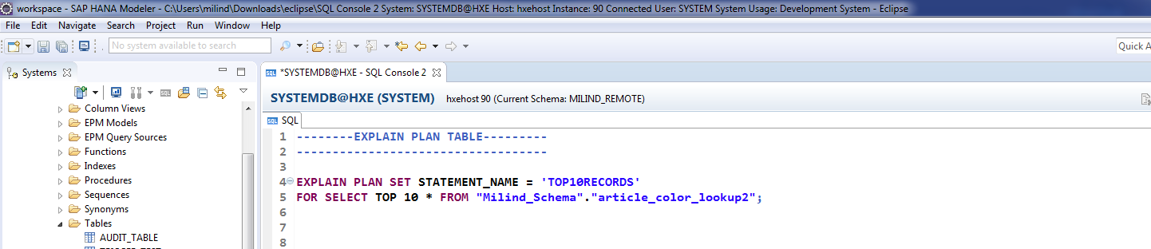
CREATE EXPLAIN PLAN TABLE.

Slide 4
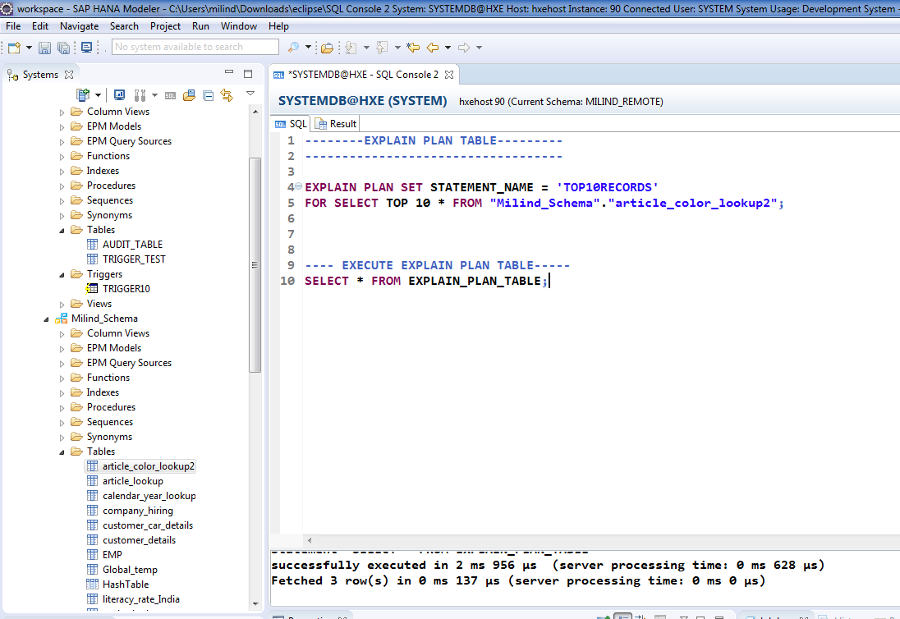
Cont.

Slide 5
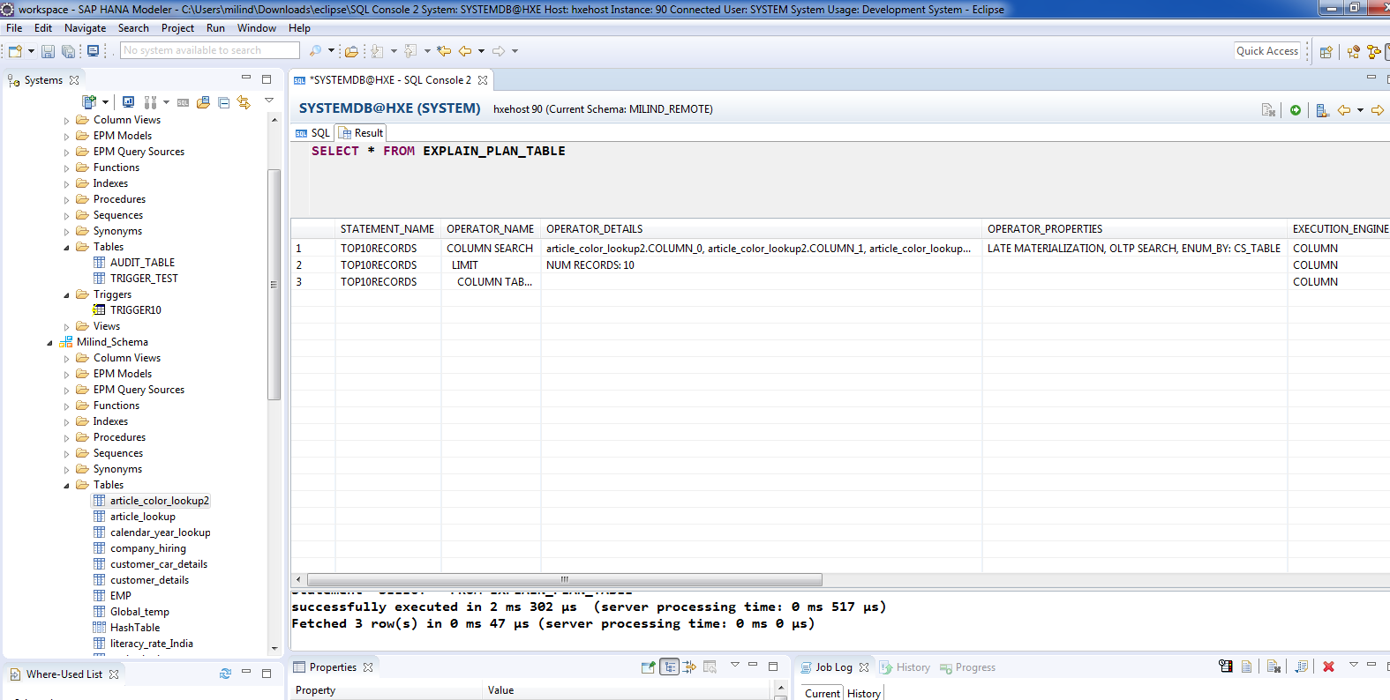
Cont. 1. Column Search 2. No. of Records 3. Looking for a schema.

